Slide 1
Feature Engineering and Feature Selection for
MACHINE LEARNING
Projects

Slide 2
What is Feature Engineering ?
Transforming Raw Data in to Features/columns
It improves accuracy.
1) Transformation in to the way that model/Algorithm can understand.
Algorithms require features with some specific characteristic to work properly
2) Derive new Features by using possible combination of existing features using Domain Knowledge

Slide 3
Steps in Feature Engineering
1.Imputation
2.Handling Outliers
3.Binning
4.Log Transform
5.Grouping Operations
6.Feature Split
7.Extracting Date
8.Deriving New Features.
9.One-Hot Encoding
10.Scaling

Slide 4
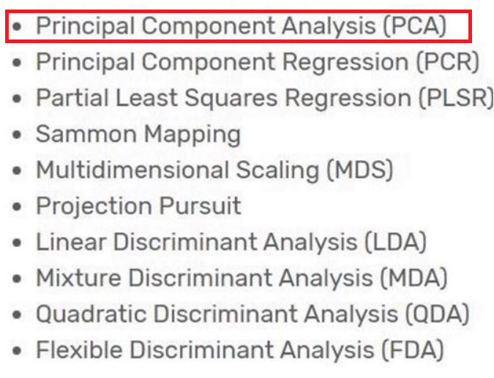
Feature Selection
Selecting the statistically significant
features for the model by
using different techniques.
Garbage in Garbage Out
Curse of dimensionality.

Slide 5
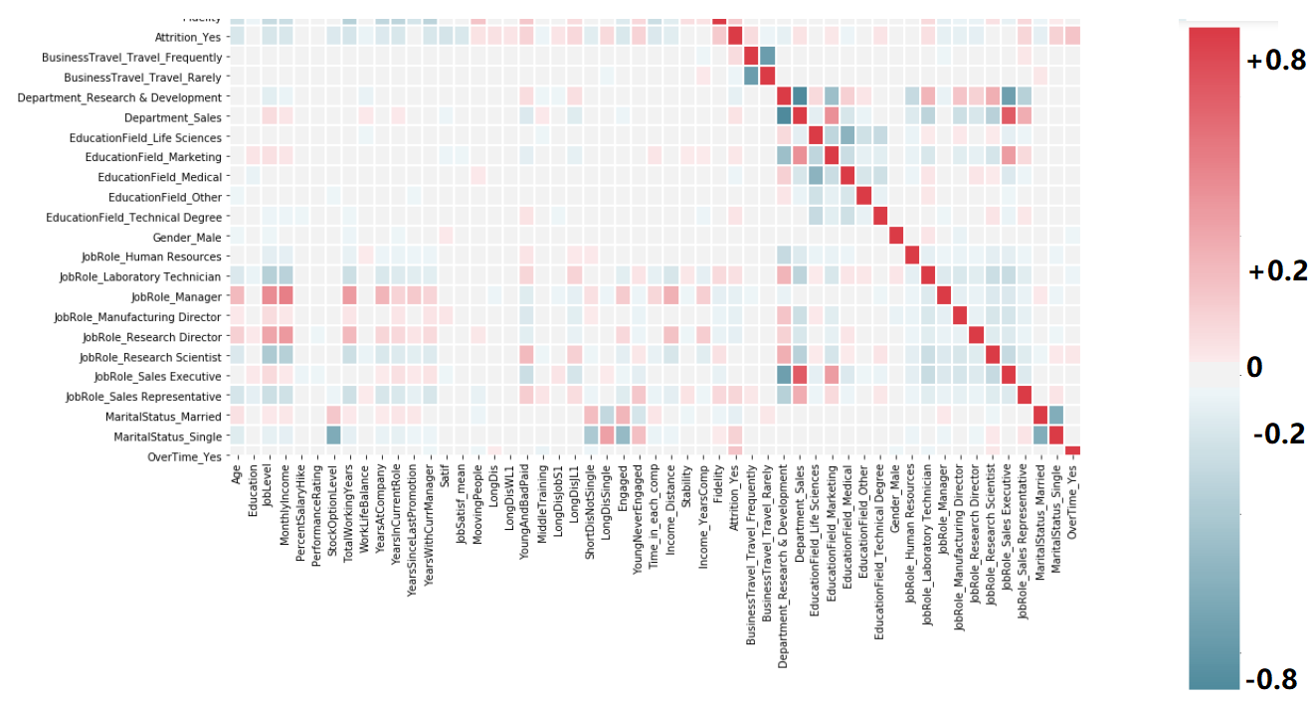

Slide 6
